Slide 1
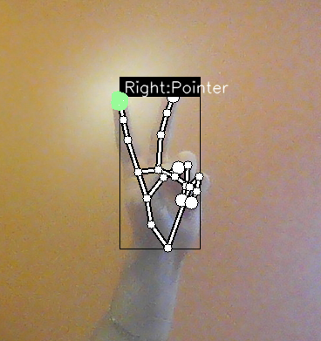
ByteMasters
Anthony Lim
Hayk Petrosyan
Karan Kumar
Leonalla Levy Martel

Slide 2
How
Google Media Pipe
Hand Landmarks Recognition
TensorFlow
Kazuhito00’s AI Model
Source : https://github.com/kinivi/hand-gesture-recognition-mediapipe

Slide 3
Technical Difficulties
Libraries versions
Discovering new technologies

Slide 4
Practicality
Makes a presentation easier
Prevents online bots with a more secure captcha

Slide 5
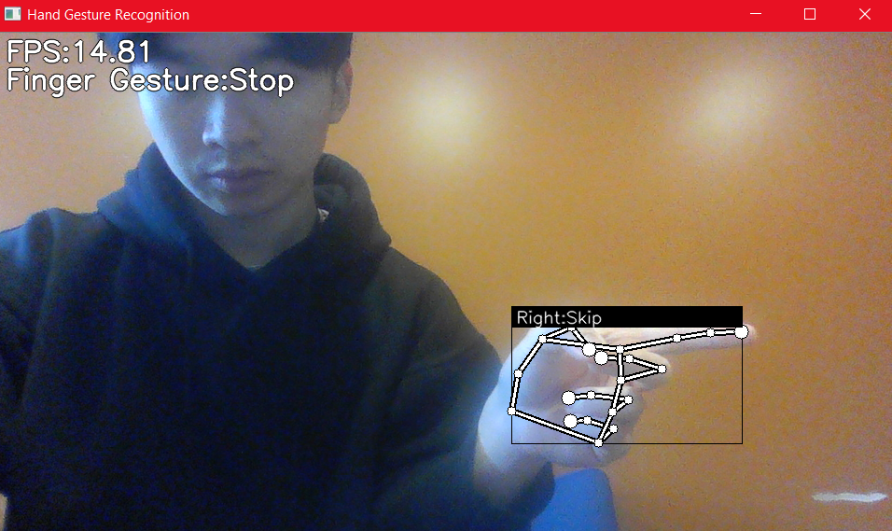
Present

Slide 6
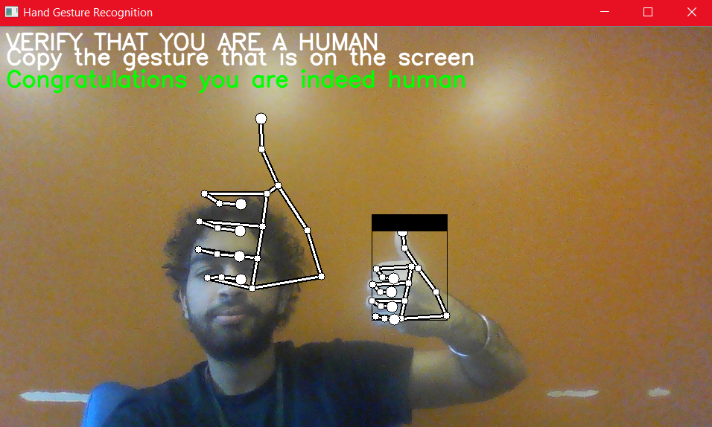
Captcha

Slide 7
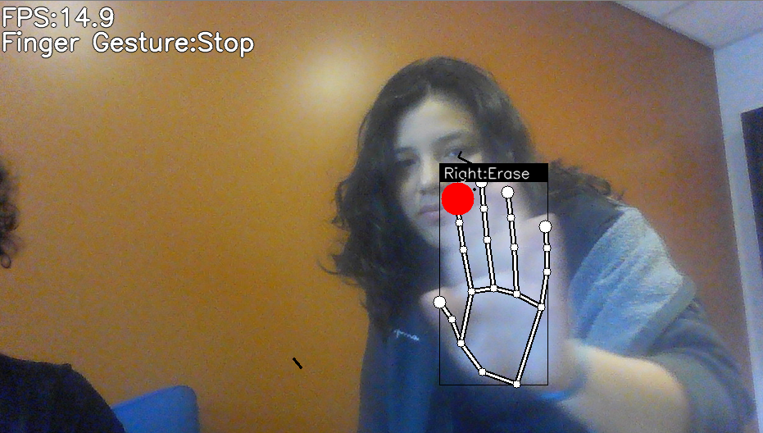
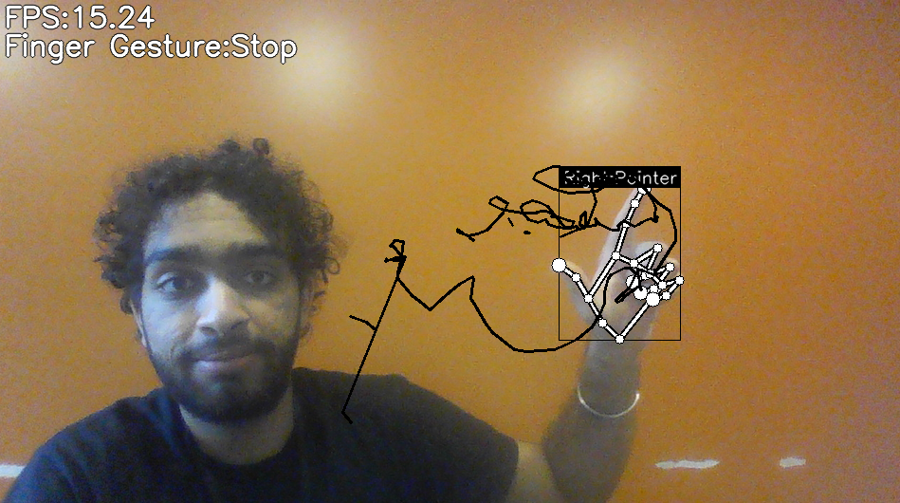
Drawing

